Slide 1

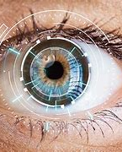
VIRTUAL EYE GAZE
TRACKING
USING COMPUTER VISION
Batch-11
Khushi Verma 217Z1A1225
Sajjal Swathi 217Z1A1250
Kommula Akshay 227Z5A1205
Under Guidance:
Mrs. P.Santhi Priya

Slide 2

OUTLINE:
ABSTRACT
INTRODUCTION
EXISTING SYSTEM
PROPOSED SYSTEM
REQUIREMENTS SPECIFICATION
DESIGN ARCHITECTURE
MODULES
MODULES
RESULT
CONCLUSION

Slide 3
ABSTRACT
Eye controlled Mouse is an innovative project designed to enable mouse cursor control using eye movements.
Enabling mouse control via eye movements for mobility impaired persons.
Adjust screen brightness automatically for better tracking using windows Management Instrumentation(WMI).
Uses OpenCV ,MediaPipe and PyAutoGUI for real time Tracking of eye movements.
The project highlights the transformative potential of integrating eye tracking and facial recognition technologies.

Slide 4
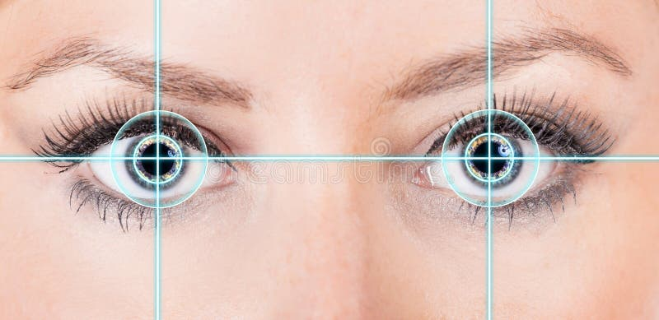
INTRODUCTION
Tracks eye movements and translates them into mouse cursor actions.​
Integrating eye tracking and facial recognition.​
Automatically adjust screen brightness​
Highlights the transformative potential to implements eye tracking technologies for everyday computer use ​

Slide 5
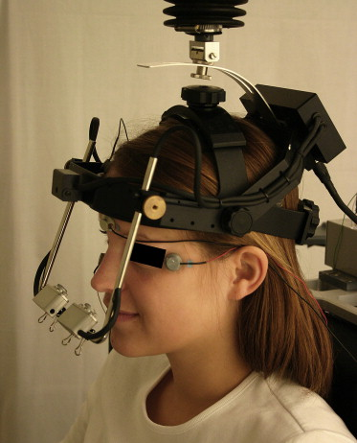
EXISTING SYSTEM
Lack of accuracy of results due to poor brightness in front of system
Need for traditional input devices to track eye movements
Lag in real time processing
High hardware dependencies
Lack of cross-platform compatibility.

Slide 6
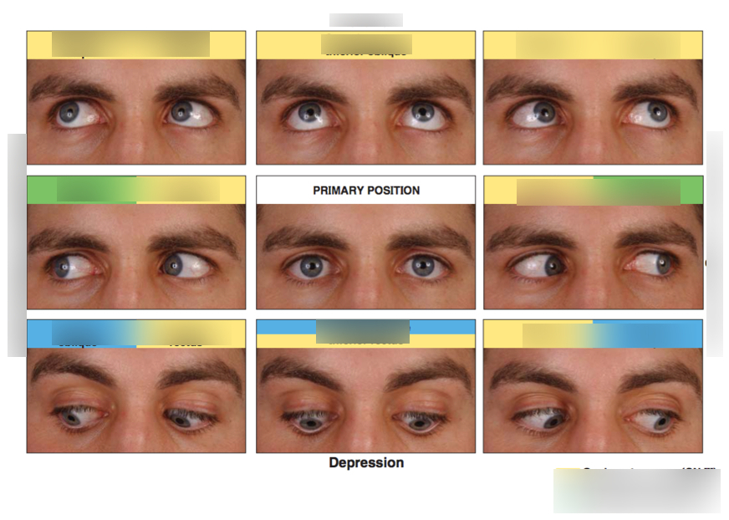
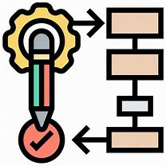

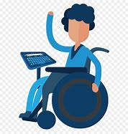
PROPOSED SYSTEM
Techniques like Haar-Cascade and Hough are used to accurately track eye movements
By leveraging open source tools like webcam
Enabling disabled people to interact with computers seamlessly

Slide 7
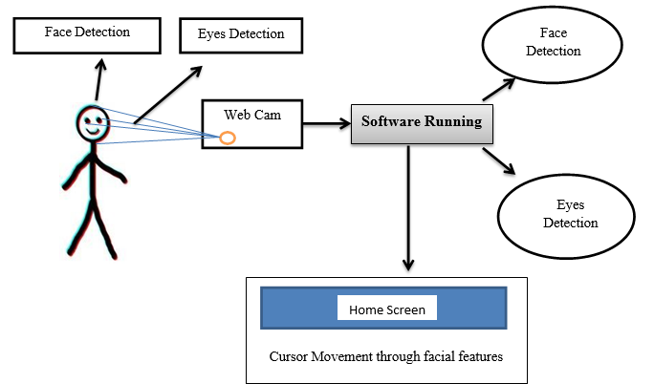

Slide 8
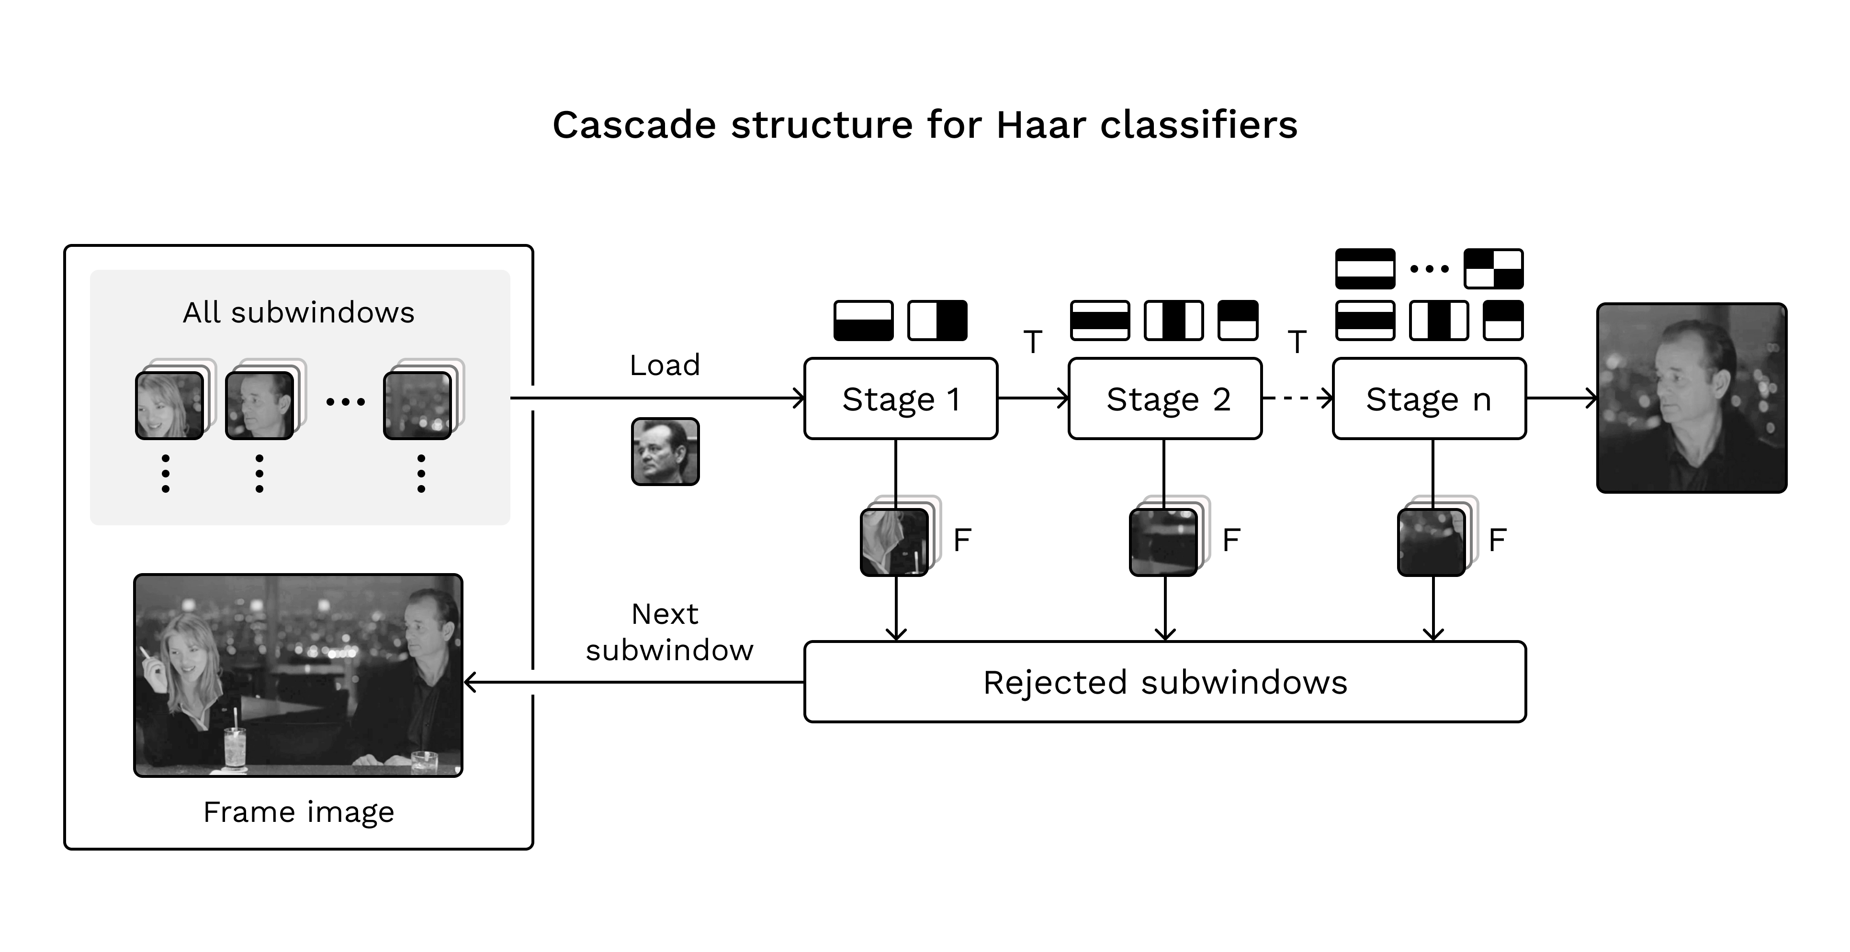
MODULE-1
OPEN CV:
OpenCV is a computer vision library that can be used for eye tracking.
Face detection using Haar Cascades.
Gaze estimation is based on pupil position.
Key OpenCV functions include Cascade classifier,Imread,cvtcolor,Gaussian color,Find conture and Hough circles.

Slide 9
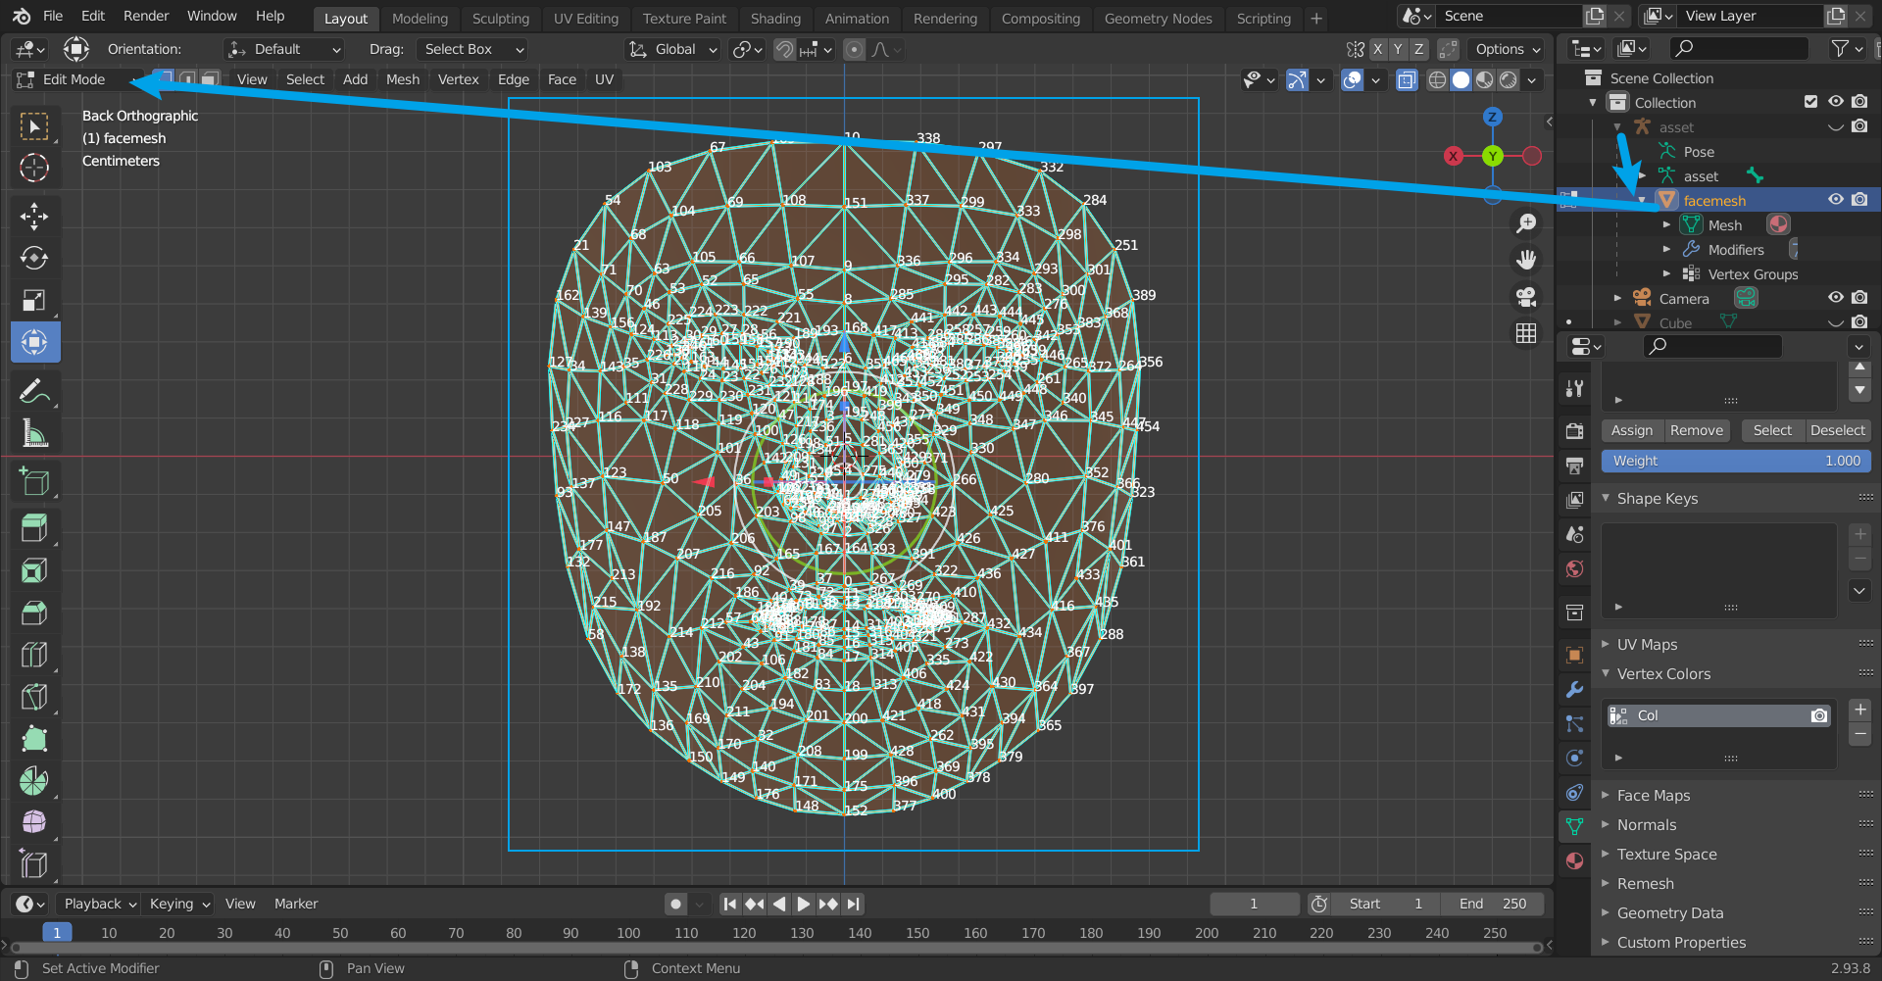
MediaPipe
MediaPipe is used alongside OpenCV for enhanced computer vision task
Key Features:Face detection,Face Mesh,Hnad Tracking,Pose Estimation and object Identification
Advantages:Real time performance and Cross-platform support
UseCases:Gesture recognition,Facial Landmark Detection,Body tracking.

Slide 10
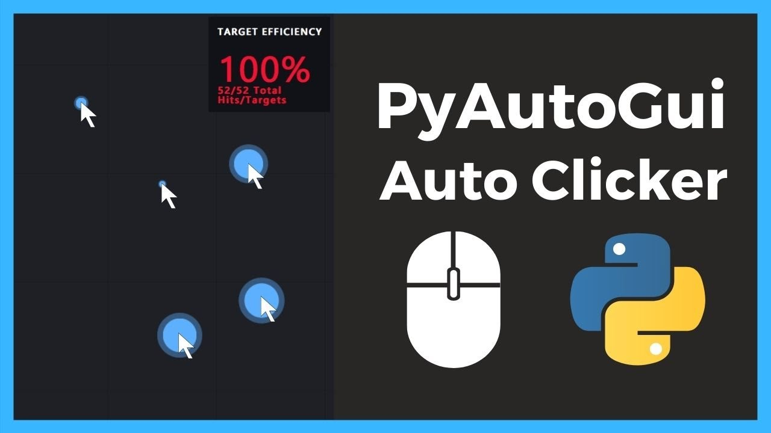
PyAutoGUI
Python Library for GUI automation and system control
KeyFunctions: moveTo(),click(),press(), scroll()
Screen capturing and image Recognition
Customizable movement speed and accuracy

Slide 11
REQUIREMENT SPECIFICATION
Media pipe
OpenCV
PyAutoGUI
WMI
Python programming language
Software Requirements
Hardware Requirements
WebCam
Processor intel i3
RAM 8gb
Storage:25

Slide 12
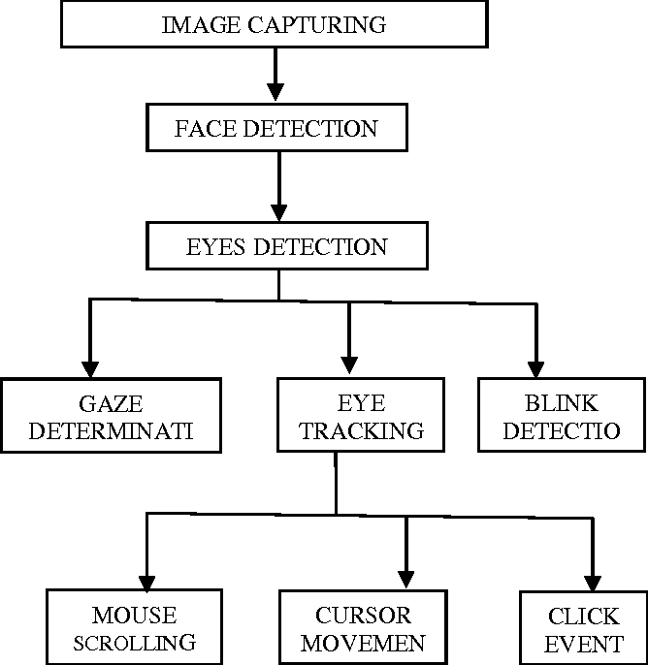
Design Architecture

Slide 13
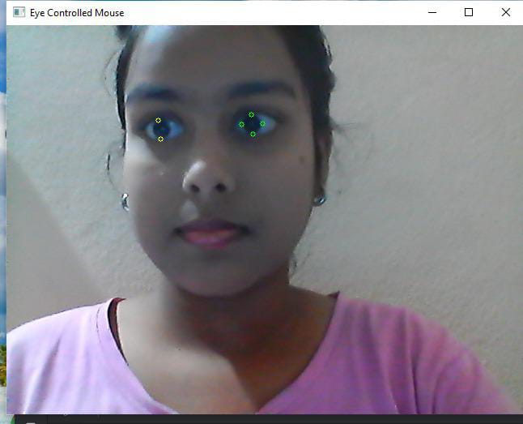
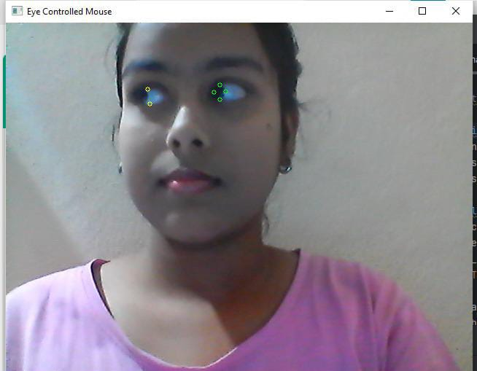
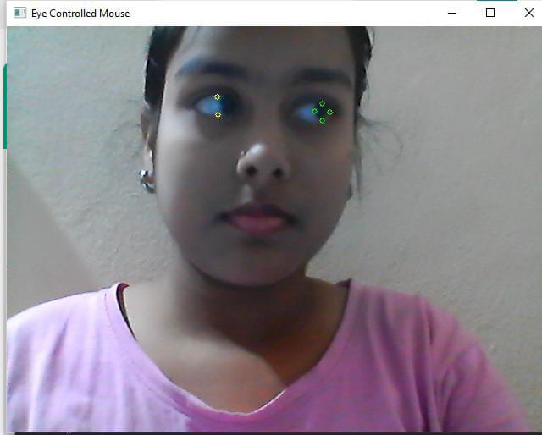
RESULTS:
Pupil Eye Detection
Left Cursor Movement
Right Cursor Movement

Slide 14


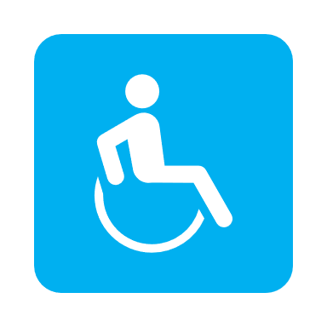

CONCLUSION
Making use of efficient algorithm in face and eye detection
Open source tools like Python,OpenCV and PyAutoGUI making system cost effective
Enables users with disabilities to operate hands-free​
Further refinements in accuracy,Usability and expanded applications​

Slide 15
THANK YOU

